Slide 1

QUALITY CHECKING
BY,
J.RAJIVEE(119013029)
S.SUSHMITA(119013041)

Slide 2
INTRODUCTION
CheckQC is a program designed to check a set of quality criteria against an Illumina run folder.
A next-generation sequencing experiment consists of a series of discrete steps that uniquely contribute to the overall quality of a data set.
Sequencing quality metrics can provide important information about the accuracy of each step in the process.
Q score is the most common metric used to assess the accuracy of a sequencing platform.

Slide 3
AIM
To check a set of quality criteria against an illumina run folder.

Slide 4
CRITERIA
Quality scores
Per sequence quality scores
Per base sequence content
Per base GC content
Per base N content

Slide 5
WORK FLOW
Collection of Data
Quality score
Per base sequence analysis
Generate plots

Slide 6

HOW DATA LOOKS…..(fastq files)

Slide 7
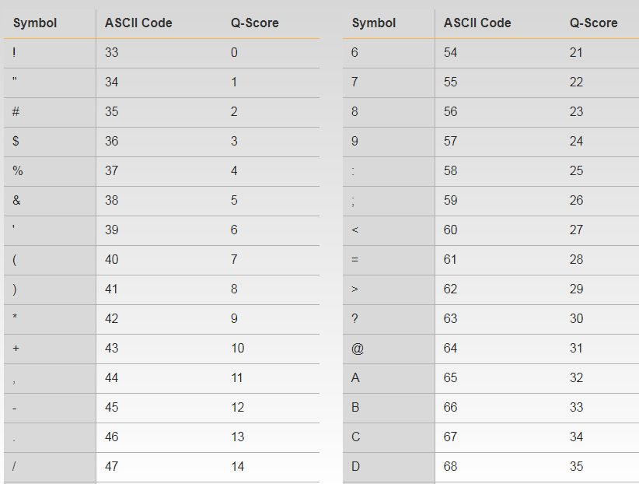
QUALITY SCORES

Slide 8
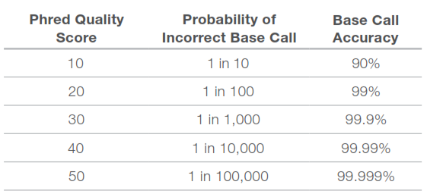
Q-SCORE RANGE

Slide 9
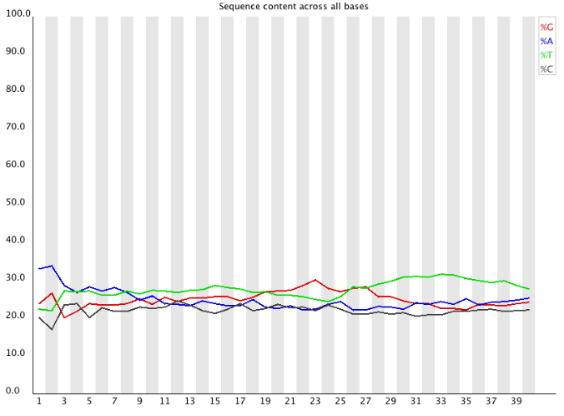
PER BASE SEQUENCE CONTENT
Per Base Sequence Content plots out the proportion of each base position in a file for which each of the four normal DNA bases has been called.

Slide 10
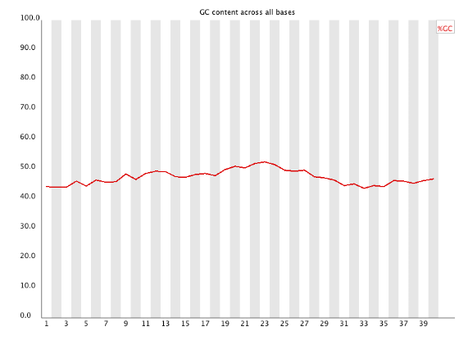
PER BASE GC CONTENT
Per Base GC Content plots out the GC content of each base position in a file.

Slide 11
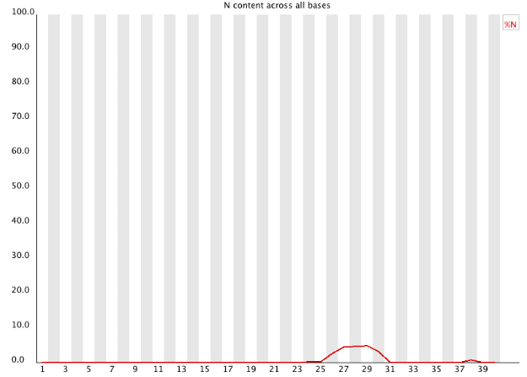
PER BASE N CONTENT
If a sequencer is unable to make a base call with sufficient confidence then it will normally substitute an N rather than a conventional base call .
This module plots out the percentage of base calls at each position for which an N was called.

Slide 12
pseudocode
Import csv
Import matplotlib
Import pandas
Different classes and functions were used for criteria checking.
Class for quality score finding
the sequence of quality score lines were taken in separate file and mapped according to the dictionary of score values.
Class for finding the range
the scores were kept in separate files and its range were found using min and max method.

Slide 13
PSEUDOCODE
Class for finding per base sequence content
Each A,T,G,C percentages were found and plotted.
Class for finding per base GC content
Each GC percentages were found and plotted.
Class for finding per base N content
Each N percentages were found and plotted.

Slide 14


